Slide 1
CASE STUDY ON REDUCING CUSTOMER ATTRITION IN TELECOM INDUSTRY
P.Bala Gangadhar
B.Mahesh
T.Dedeepya
S.Rakesh

Slide 2
Contents
CUSTOMER ATTRITION
CUSTOMER RETENTION AND ITS BENEFITS
ISSUE TREE
GHOST PACK
MODEL SUGGESTION
CONCLUSION

Slide 3
ATTRITION
What is Customer Attrition ?
Why Customer Attrition is bad to Company ?
How to tackle this ?

Slide 4
What is customer attrition?
Customer attrition refers to the percentage of customers that ended the usage of your service during a certain period of time.
Customer attrition is also known as customer churn
Customer churn is one of the most important metrics of a growing business to evaluate.

Slide 5

How can we calculate Customer churn rate?

Slide 6
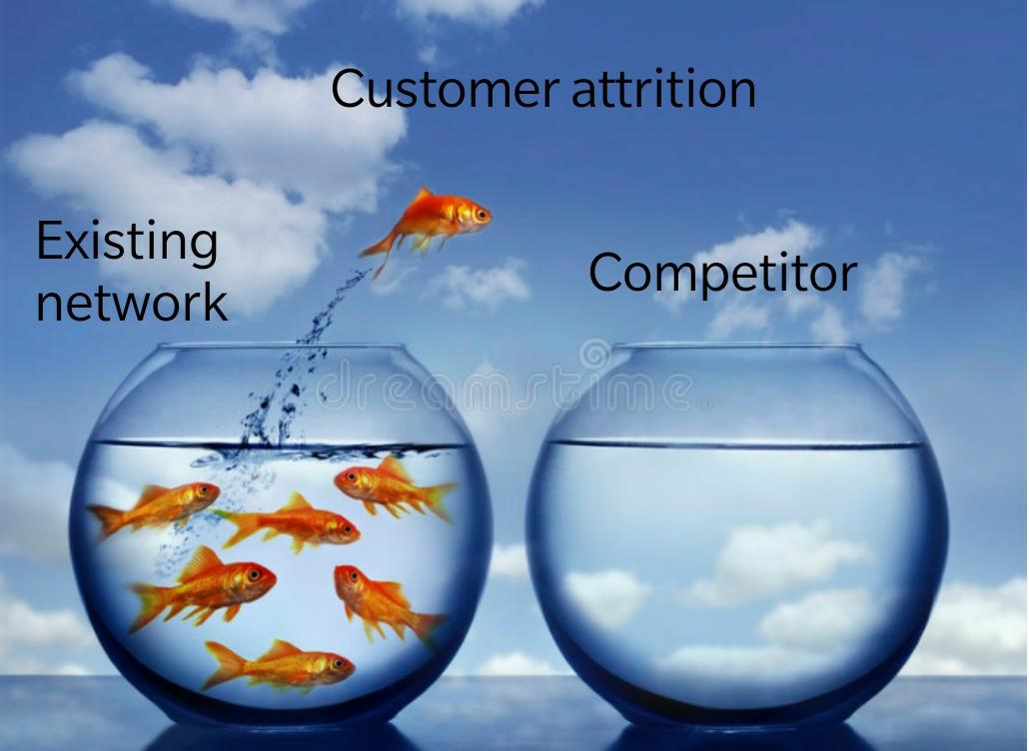

Slide 7

CUSTOMER RETENTION
In Telecom,Customer Retention is a systematic effort to encourage their customers to remain within their Network.

Slide 8
Benefits of Customer Retention
Retained Customers are tend to buy other services from same Company.
Retained customers are known to be less price/cost sensitive.
Positive word of mouth.
Free Marketing 24/7.
Declined Migration Rates.
Remember it's more expensive to acuire a new customer
than to retain an old one.

Slide 9
Major Reasons For Attrition
Poor Network Issue
Tariff Plans
Security Issues
Customer Attrition
Brand Image
Competitors

Slide 10
Sub Issues
Connectivity complexities
Poor Network
Internet Speed
Heavy Charges On Plans
Tariff plans
Unable to Provide Flexibility
in plans for customers

Slide 11
Misusage of confidential
information.
Security Issues
Telecom Fraud
Spam messages
Competitors
Under Estimating the
competitors
Brand Image
Sloppiness in advertising

Slide 12
Ghost Pack
ISSUES | RECOMMENDATIONS
1.Connectivity complexities. | Most important aspect for any telecom industry to become successful service provider is to ensure a uninterrupted connections and a quality service.
2.Internet Speed. | In this generation the usage of smart phones has sky rocketed so every customer is expecting a stable high speed internet so making 4G available in all locations and achieving a stable internet speed is necessary.
3.Heavy Charges on plans. | JIO telecom has taken Indian telecom industry by storm it has achieved huge success in a very short time the main reason behind its success is providing costly plans at a very ECONOMICAL PRICE.

Slide 13
ISSUES | RECOMMENDATIONS
4.Unable to Provide Flexibility in plans for customers. | Tariff plans offered by a telecom industry should be comparable to competitors in market if not lower. Customer segmentation should be done and accordingly plans should be implemented.
5.Misusage of confidential information. | Selling the customers privacy data for personal gains. Data Privacy Rights should be protected.
6.Telecom Fraud. | For our users we need to provide security by adopting biometric E- SIM cards for curbing crimes related to mobile phones and terrorist attacks as well.

Slide 14
ISSUES | RECOMMENDATIONS
7.Spam messages | Telecom operators must ensure that only unsolicited commercial communication shall take place for registered senders.
8.Competitors | Any Telecom industry should not underestimate their competitors and should have an eye on their activities in order to upgrade at the earliest.
9.Sloppiness in Advertising | Being Careless in advertising the product may hurt regional, religion feelings which may have the backlash on the company. So, extra care has to be taken to promote the product in the society.

Slide 15
Some Recommended Advices
Being active on Social Media and eavesdropping on what customers are talking about our comapny.
Because In today's world Socia Media is a power full resource if used properly it can do wonders.
Reward Loyalty.
Innovate and shout about your differentiating qualities.

Slide 16
Customer Feedback Loop
Customers want to feel valued.
If they don’t, they are likely
to switch to a competitor
offering them a better deal.
The customer feedback loop
is the practice of responding to
customers meaningfully when
they leave feedback.
How building a good Customer
Feedback Loop will help companies ?

Slide 17
Example :
“Thank you for your feedback”, the company should make it easy for a happy customer to buy more. Why not send a personalized offer, mentioning specifically what the customer said?

Slide 18
Using Data Analytics For Further Improvement
A number of predictive models are provided in the Telecommunications field.
1.Customer Satisfaction model: Customer satisfaction in the Telecommunications sample is determined by the Net Promoter Score (NPS) Based on this score necessary steps should be taken.
2.Association model: An Association model is used to assign the right offer to a customer.

Slide 19

How to identify a pool of customers that ready to churn out?

Slide 20
3.Churn model:
Churn reduction in the telecom industry is a serious problem, but there are many things that can be done to reduce it, and, with a customer database.
Analyse the churn out customer's data.
Predict a pattern depending on the data analysis done and apply it on the existing customers to know the customers having high probability to churn out so that we can improve the service for them.

Slide 21
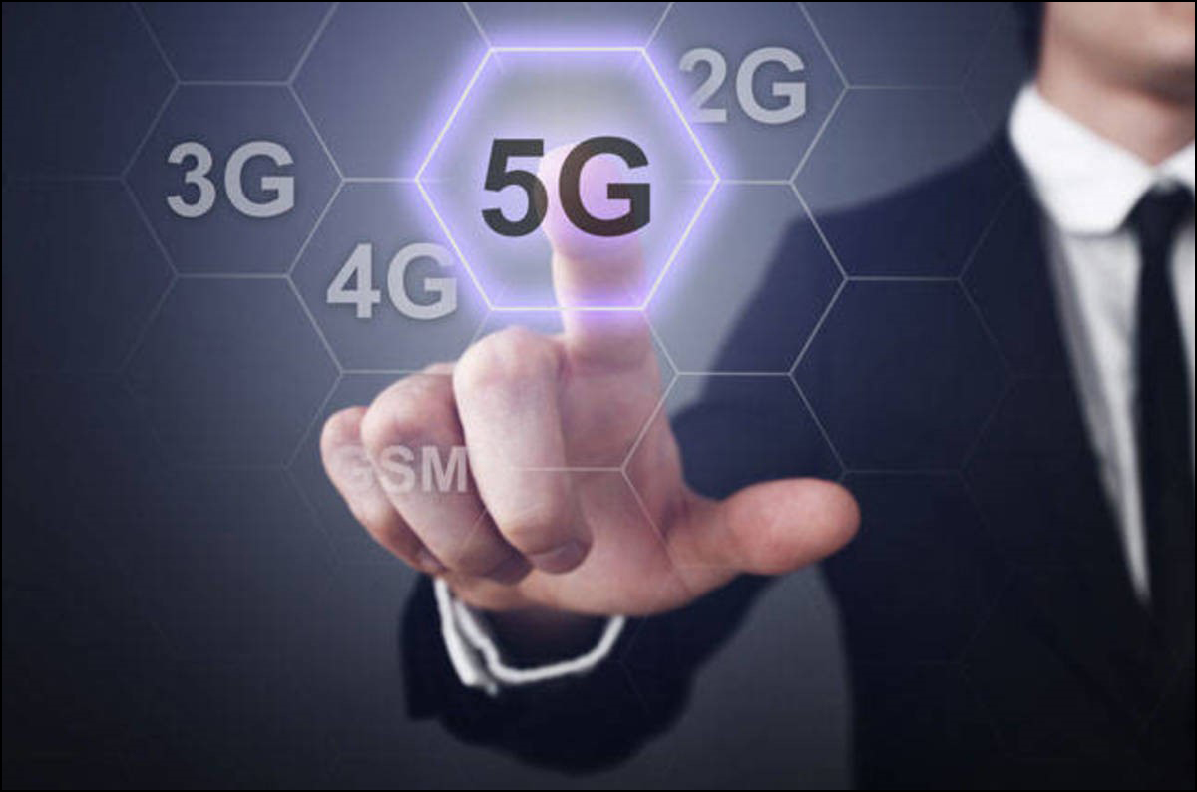
Challenges in telecom industry in future
1.5G Network

Slide 22

2.Internet of things(IOT):
Gartner predicts that there will be nearly 20 billion devices connected to the IOT by 2020 and that IOT product and service suppliers will amount to a business of $300 billion in revenue.

Slide 23
3.Mergers & Acquisitions
With cut-throat competition, new technological innovations disrupting the existing customer base, the year doesn’t seem to be very easy for the telecommunication sector. That’s why a number of companies are looking to partner with media and content firms, like Hotstar,music apps,Netflix etc.

Slide 24
CONCLUSION
Churn reduction in the telecom industry is a serious problem, but there are many things that can be done to reduce it.

